Slide 1
ASP.NET Core
Building Web Applications using the MVC Architecture

Slide 2
What is Core
The latest Microsoft technology for building applications and services.
It’s a .NET framework that has been completely redesigned from scratch.
  .NET Core 8.0 is the latest version of the framework.
.NET Core vs .NET
  Core is built to run on multiple platforms (Windows, MacOS, Linux).
  Designed for high-performance and scalability.
  Microservice architecture allows a mix of different technologies like the ability to work with Java, Ruby, and other technologies.
  Allows multiple versions to be installed and running side-by-side on a single server.
    Multiple services and apps can reside on the same server each with their own version of .NET Core, which lowers risk and saves money with application upgrades.

Slide 3
ASP.NET vs ASP.NET Core
Both frameworks essentially do the same thing.
  ASP.NET and ASP.NET Core are the part of the .NET framework used to build Web applications.
ASP.NET Core can run on a variety of different server platforms.
  ASP.NET is built for Windows.
ASP.NET Core was built for Web Developers
  ASP.NET uses Web Forms, which made it easy for developers familiar with Windows Forms Applications to transition to Web applications.
  ASP.NET Core uses Razor Pages that give Web developers more control of the user interface.
ASP.NET Core is highly testable through Unit Testing.
  ASP.NET couldn’t use .NET’s Unit Testing features.

Slide 4
ASP.NET vs ASP.NET Core
ASP.NET Core completely decoupled ASP.NET Application Server from the Web Server (Microsoft’s IIS).
  Separating the functions of the web server from the web application.
  ASP.NET Web applications must be hosted on a Microsoft IIS Web Server.
  ASP.NET Core Web applications do not have this restriction.
The Open Web Interface for .NET (OWIN) Architecture allowed for this separation.
  This architecture defines a standard way for the usage of middleware in a pipeline to handle the processing of requests and their responses.
  Middleware is the “software glue” that provides services outside the scope of an operating system.
    Services like data services, application services, messaging, API management, authentication, etc…

Slide 5
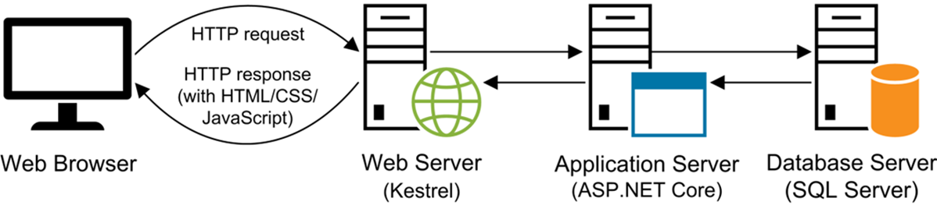
ASP.NET Core
Processing Web Requests in ASP.NET Core:

Slide 6
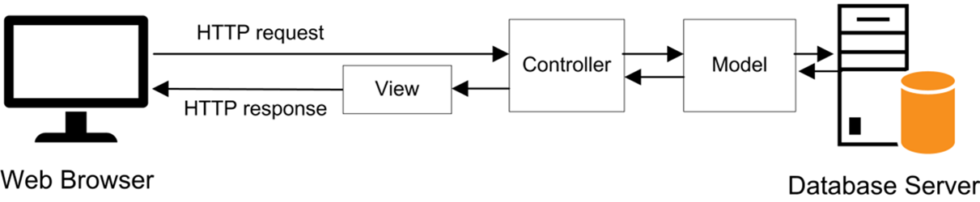
ASP.NET Core
ASP.NET Core MVC Web Application:

Slide 7
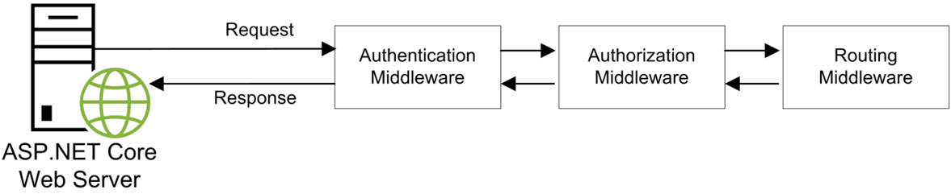
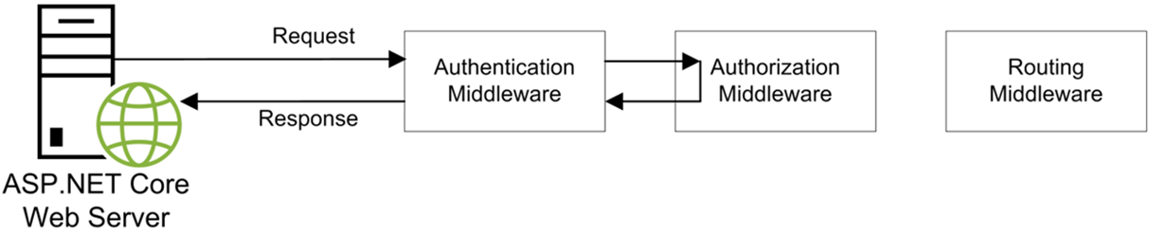
ASP.NET Core
ASP.NET Core & Middleware Pipeline:

Slide 8
ASP.NET Core
Insert diagram to demonstrate the web server and application
Also, create a diagram of the pipeline with middleware.
See Murach’s book for a few diagram ideas.

Slide 9
ASP.NET Core MVC

Slide 10
MVC vs Web Forms
MVC is a design pattern for building applications.
  It’s a completely different design model than Web Forms.
MVC isn’t new to Core.
  It was available in ASP.NET, too.
Differences between MVC and Web Forms:
  The project structure, files, and organization is different.
  There is no drag-and-drop Form Designer tool in MVC.
  The page’s markup language is different.
    No more <asp:TextBox …>
  MVC requires a good understanding of object-oriented programming and component-based software design.

Slide 11
Model-View-Controller (MVC)
Model-View-Controller (MVC) refers to a software design pattern that involves separating elements of an application into 3 distinct parts.
The Model is the part that does the actual work for the application.
  The Model manages the behavior and data of an application.
  It’s independent of the View and the Controller.
  The Model should provide a means (methods) for View and Controller to use.
  Independence provides flexibility and reusability.

Slide 12
Model-View-Controller (MVC)
The View is the part that allows the user to view information and interact with an application.
  In simple terms, it’s the GUI or user interface of the application.
  It shows the results of operations performed by the Model, and what the Model looks like after it performs an operation (the state of the Model).
In ASP.NET Core MVC, the View is a template comprised of HTML and language specific elements that must be rendered before the browser can handle it.

Slide 13
Model-View-Controller (MVC)
The View Engine is the component responsible for processing the View by building the HTML output delivered to the browser.
  The Razor Engine, which can be used with Razor Views or Razor Pages, is the default.
Other View Engines can be used to handle other View templates and languages.
  You can create a custom View Engine and View template language, too.
  ASP.NET Core’s architecture separated this functionality, too; now, it’s part of the middleware.
We will be using the Razor Engine and Razor Views.

Slide 14
Model-View-Controller (MVC)
The Controller is the part that connects the View to the Model.
  Determines the user interactions occurring on the View.
  Retrieves input from the View to deliver to the Model.
  Initiates actions to be performed by the Model.
  Updates the View based on the state of the Model or displays results returned by the Model.
It tells the Model what to do, but not how to do it.

Slide 15
MVC Example – The Model

Slide 16
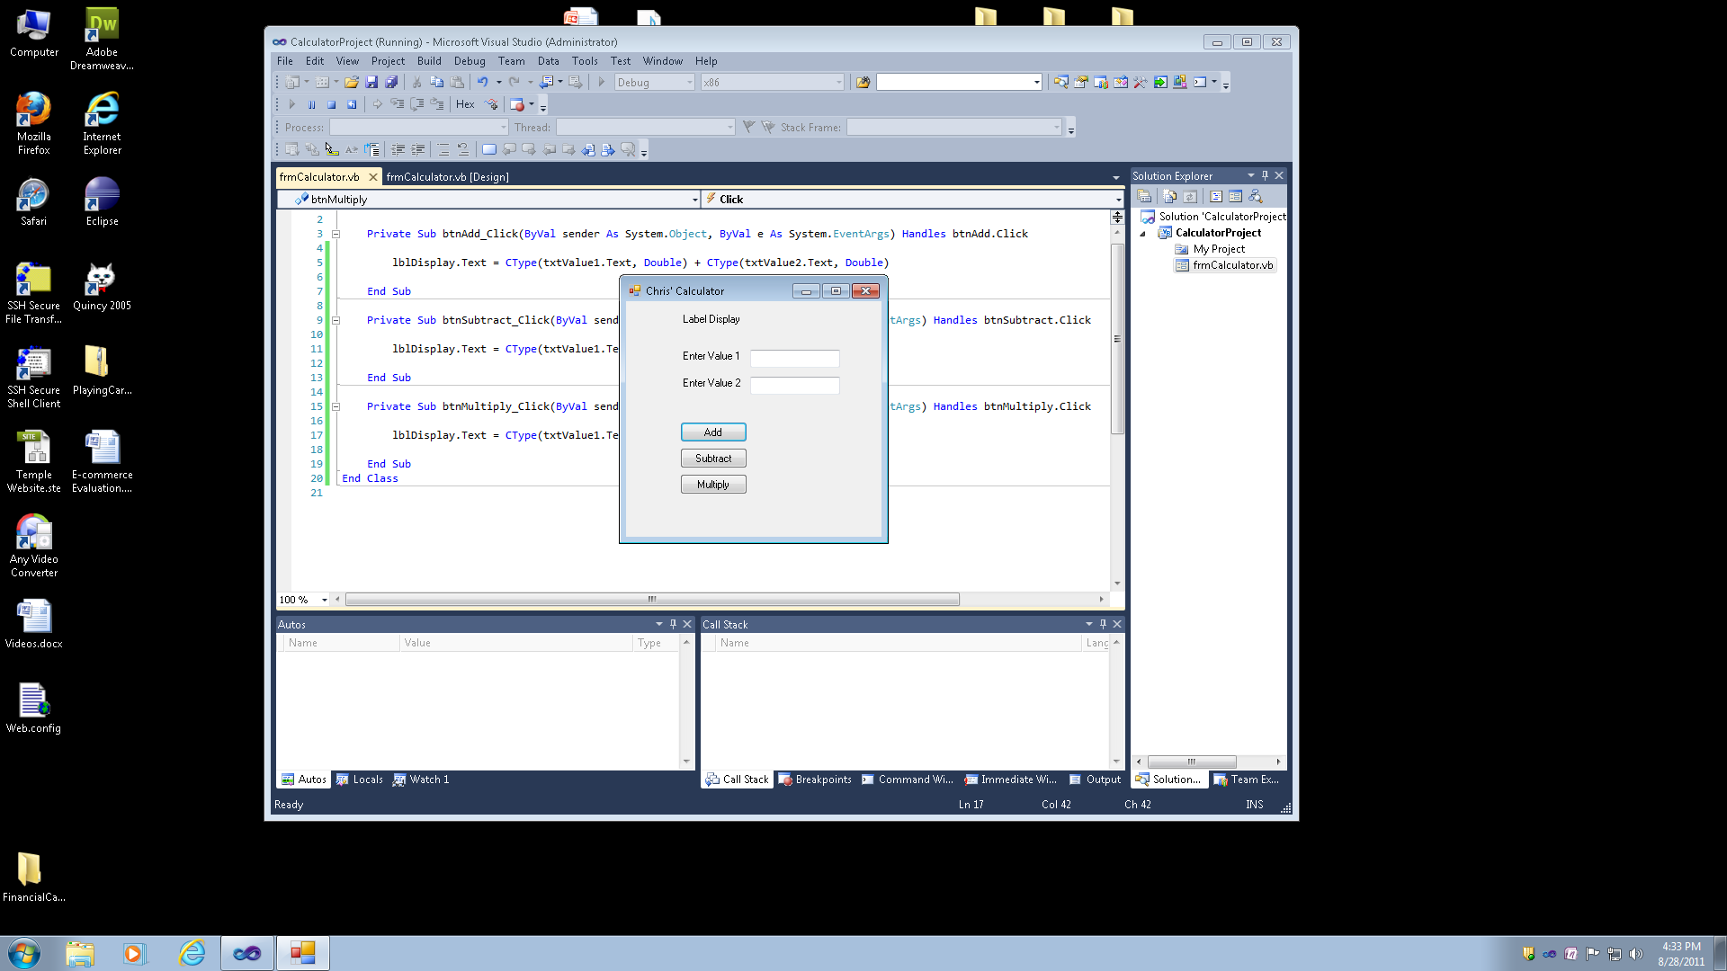
MVC Example – The View

Slide 17
MVC Example – The Controller

Slide 18
ASP.NET Core MVC
Main components of MVC:
  Areas
  Dependency Injection
  Model Binding
  Model Validation
  Razor Views / Razor Pages
    Tag Helpers
  Routing
  Views
    Partial Views
    Layouts
    View Components

Slide 19
Understanding Core MVC
Areas are a way of organizing larger projects by partitioning them into smaller functional units.
  This is not necessary to the functioning of your application.
Routing allows the mapping of an incoming HTTP request to the appropriate handler of the request.
  Conventional Routing and Attribute Routing.
Dependency Injection is a software design technique that involves loosely coupling classes and their dependencies.
  It mainly involves using Interfaces, so there isn’t a specific dependency on a concrete class.
  See this article for more information on Dependency Injection.

Slide 20
Understanding Core MVC
Model Binding is a process that involves converting data sent from the client’s request into objects used by controllers and their action methods.
  It’s an automated feature that saves us time in digging out the values from the request.
  See this article for more information on Model Binding.
Model Validation handlers validating the client’s data before a controller’s action method is executed.
  The framework allows for both client-side and server-side validation.
  See this article for more information on Model Validation.

Slide 21
Understanding Core MVC
Razor Views and Razor Pages are dynamic server pages that contain Razor syntax and HTML that make up a View.
Layouts provide a consistent look to a web site and allow you to reuse elements of a page.
  Share reusable elements like a header, menu, navigation, footer, etc… on multiple pages.
  Reduces the amount of redundant code.
Partial View is a reusable View that can be included as a child of another View.
  Allows the ability to handle multiple views within a single page.
  It’s like Master Pages and Content Pages in ASP.NET.

Slide 22
Understanding Core MVC
View Components are similar to partial views, but they are more powerful.
  They are typically used when the view’s reusable rendering code is too complex for a partial view.
Razor Views vs Razor Pages
  The main difference is that a Razor Page is page-focused.
    It’s like an ASPX page in ASP.NET.
    There is an HTML/Razor markup page with a code-behind specifically attached to the page it processes.
  Razor Views are API-focused.
    The view contains HTML/Razor markup content that can be processed or delivered by any Core API controller or method inside a controller class.

Slide 23
Working with MVC

Slide 24
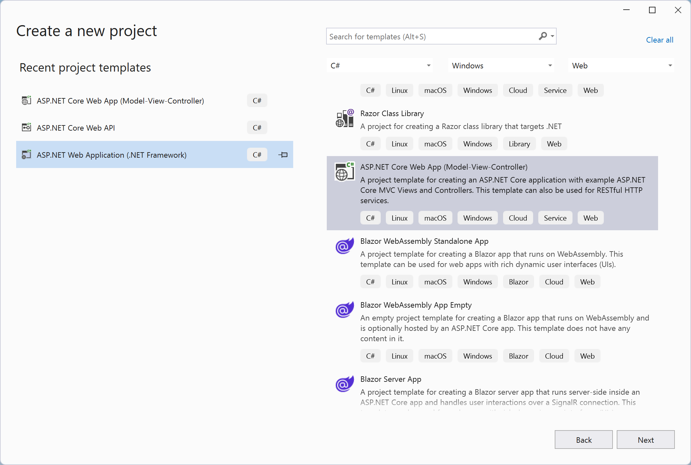
Creating an ASP.NET Core MVC Web Application
Open a Visual Studio Solution, select a Project in the solution, right-click, and select Add >>> New Item.
Select Core Web App (MVC)

Slide 25
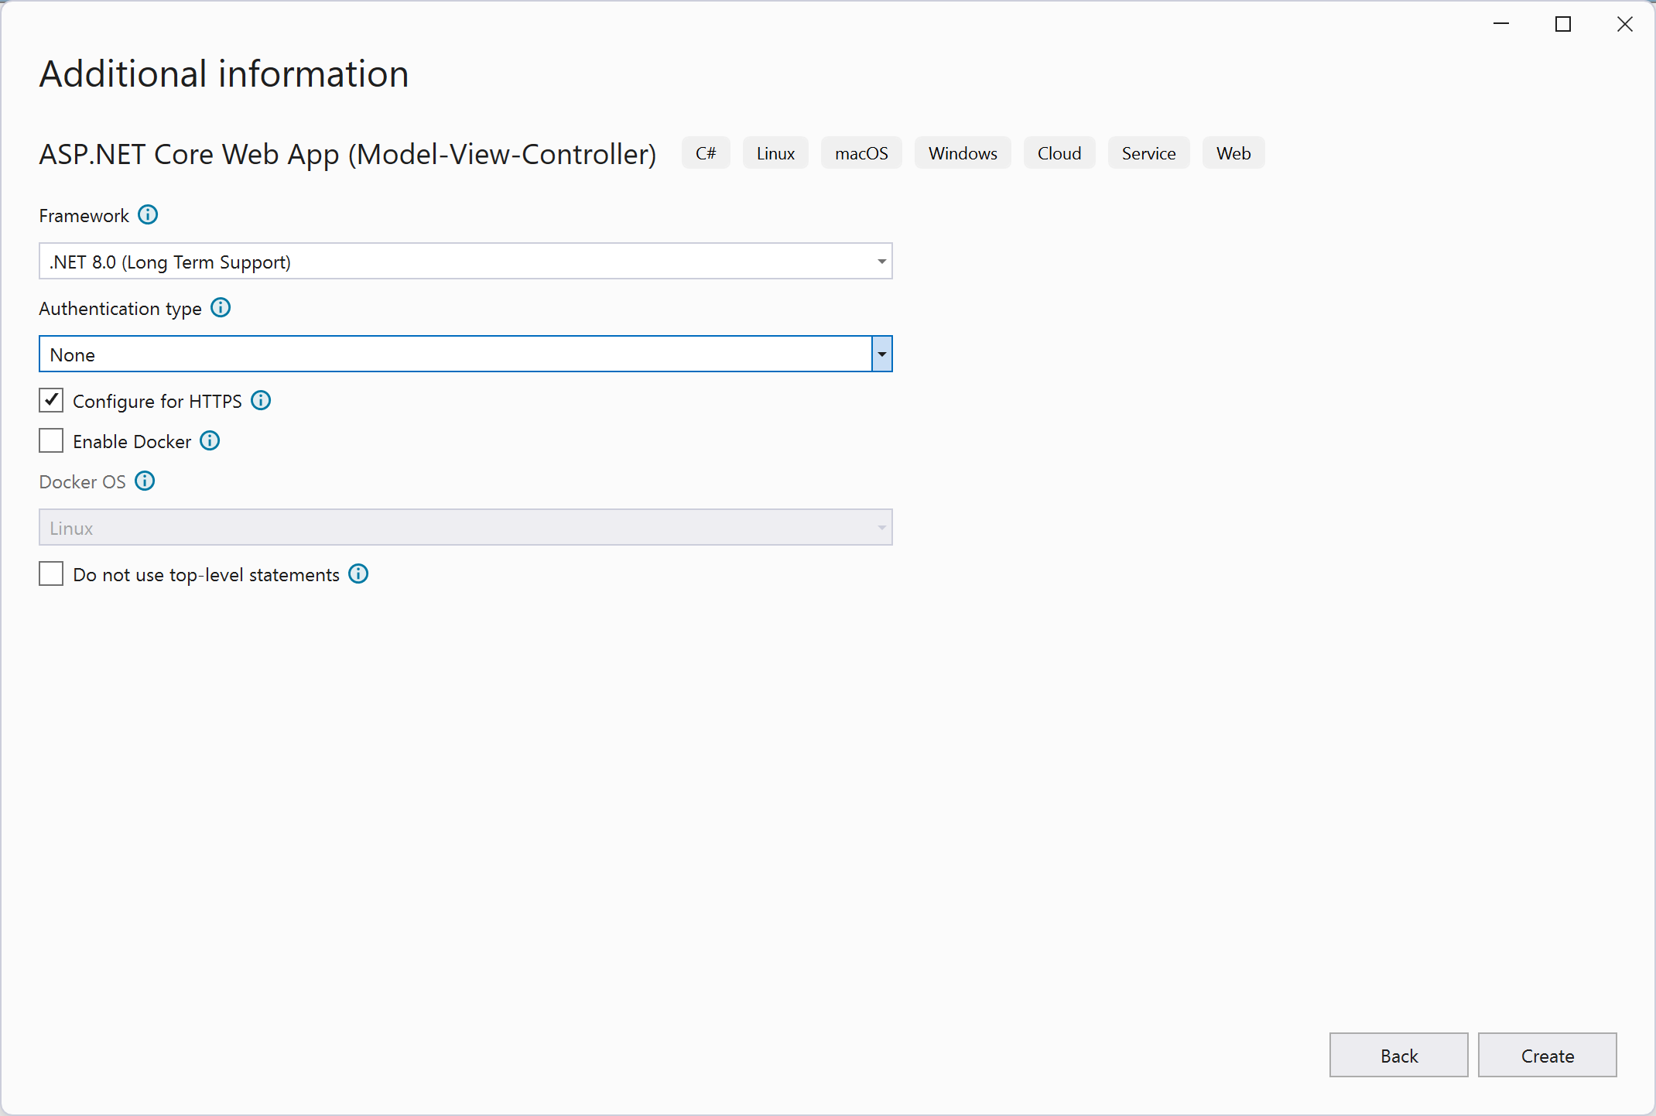
Creating an ASP.NET Core MVC Web Application
Select the highlighted template type from the types of Core Web Applications.
Choose Framework

Slide 26
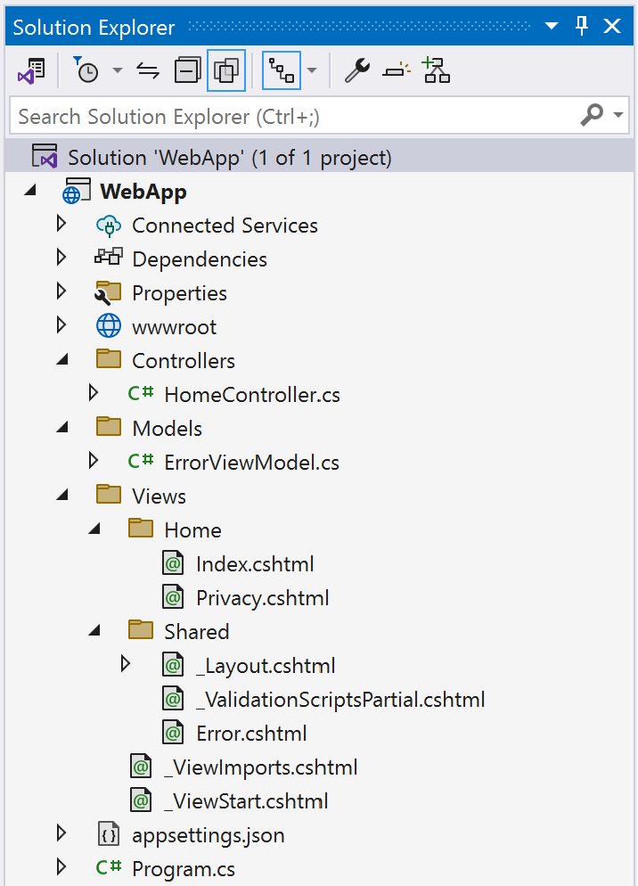
Creating an ASP.NET Core MVC Web Application
Structure of a Core Web Application:
Website’s files (html pages, css, images, script files, etc…)
Controllers used in the application
Model classes used by all Controllers in the application
Home Controller’s Views
View that contains global settings and imports used by other Views.
Views shared by all Controllers

Slide 27
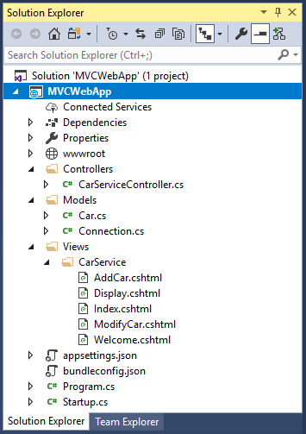
Creating an ASP.NET Core MVC Web Application
Example Core Web Application:
Folder that contains the Views used by the CarService Controller

Slide 28
Creating an ASP.NET Core MVC Web Application
Comprehensive tutorial that demonstrates how to create an ASP.NET Core MVC Web Application.
MSDN tutorial on Views in ASP.NET Core MVC.
MSDN’s Introduction to Razor Pages.

Slide 29
Working with MVC
The Controller is the same as we learned in Web APIs; however, the controller will be returning Views instead of JSON, XML, and strings
  The controllers in MVC can return Views that are processed by middleware to produce the content delivered to the browser or client.
Also, Routing and Model Binding is the same, but we will see some new concepts regarding Models and Model Binding that we didn’t discuss in Web APIs.
  View Model
  Strongly and Weakly Typed Views
  Model Validation

Slide 30
MVC Views
The View handles the presentation of the application’s data and user interaction.
  The newest concept that we will discuss.
Razor Views are a type of View.
  Templates that contain HTML and Razor syntax.
  They have a cshtml file extension.
Razor Views cannot be accessed by the browser like other file-based frameworks, such as ASP.NET (Web Forms), PHP, and JSP.
  The browser cannot directly request a Razor View.
  A controller’s action method will specify a Razor View that will produce the HTML output or other content delivered to the client.

Slide 31
MVC Views
In ASP.NET Core MVC, a controller typically returns a view.
  A controller’s action method can return a ViewResult, which is a type of ActionResult.
  Uses a return statement that calls the View() helper method.
The View Discovery process is initiated when a controller’s action method returns a view.
  This process determines the view file based on the view name or view path.
  After the discovery process, the view is rendered into HTML and sent back to the client.
Visit this MSDN resource for more information on Views.

Slide 32
View - Razor View
Sample Razor View (Index.cshtml):
Import statement includes all the Model classes for use in this page.
Import statement that is needed to use Tag Helpers

Slide 33
View - Razor View
Controller that delivers the Index.cshtml Razor View:
The View() method returns a View (Razor Page) with the same name as the Controller’s Action Method.
The View() method can be passed the name (without the cshtml file extension) of the Razor View delivered to the browser. When the method is called without an input parameter, it will automatically look for a Razor View with the same name as the Controller’s Action Method.

Slide 34
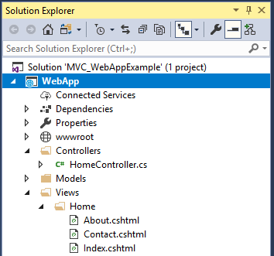
View - Razor View
The project structure and files used in the example shown on the previous slides:
The file that contains the Controller code demonstrated on the previous slide.
The file that contains the Razor View code demonstrated on the previous slide.

Slide 35
Razor Basics
Razor Code Expressions:
  Razor code begins with the @ symbol.
  Razor code uses C# as the programming language.
  Example:

Slide 36
Razor Basics
Razor Expressions:
  Razor code and HTML are typically mixed together to produce the View.
  Allows the programmer to execute some code that will get evaluated.
  Example:

Slide 37
Razor Basics
Razor Comments:
  A comment block in Razor begins with @* and end with *@.
  Comments are ignored by the compiler just like any other programming language.
  Example:

Slide 38
MVC Views
Views typically rely on data from the Model.
  One of the main functions of a View is displaying the model’s data.
Passing data from the Controller to the View:
  ViewData
  ViewBag
  ViewModel
View
Data
Controller

Slide 39
Passing Data from Controller to View
There are two methods of passing data from the Controller to the View.
  Weakly typed data - ViewData and ViewBag
  Strongly typed data - ViewModel
Weakly-typed View
  Dynamic data types with no type checking.
  You need to perform costly type casting operations.
  Unable to use Intellisense in the Visual Studio IDE.
A Strongly-typed View takes advantage of type checking done at compile time.
  Known as the ViewModel, which involves the use of strongly typed model classes in a view.
  The preferred method to use.

Slide 40
ViewData & ViewBag Dictionaries
The ViewData and the ViewBag are built-in data dictionaries that can be used to pass data from the Controller to a View.
  The dictionaries utilize key/value pairs.
  Both do the same thing.
  The data in the ViewBag is automatically synced with the ViewData.
Storing data:
ViewData[“Username”] = “BW”;
ViewData[“LastLogin”] = “1/1/2020 2:00PM”
ViewBag.Firstname = “Bruce”;
ViewBag.Lastname = “Wayne”;

Slide 41
ViewData & ViewBag Dictionaries
Retrieving data:
var login = ViewData[“Username”];
var lastLogin = ViewData[“LastLogin”];
var fullName = ViewBag.Firstname + “ “ + ViewBag.Lastname;
The ViewBag content is automatically synced with the ViewData dictionary.
ViewData[“PageTitle”] = “Course Listing”;
var title = ViewBag.PageTitle; // title contains the string “Course Listing”

Slide 42
ViewData & ViewBag Example
Razor View Code:
This example demonstrates using the ViewData and ViewBag within the Razor View’s code. The next slide shows how the controller passes the data used in the view.

Slide 43
Passing Data from Controller to View
Razor View Code:
Controller Code:
This example demonstrates data passed from the controller to the view using the ViewData and ViewBag dictionaries.

Slide 44
Passing Data from Controller to View
Razor View Code:
Controller Code:
Passes the car model object used in the Razor Page (view)
References the car object passed to the view.
The @model directive is used to specify the model class used by the view. The model object (@Model) used by the view is passed into the View() method.

Slide 45
Passing Data from View to Controller
A form is required in order to pass data from the View to the Controller.
Form data is sent through an HTTP Post or HTTP Get request.
Accessing form data from the Controller can be done in several ways:
  Form collection
  Parameters
  Query String
  ViewModel

Slide 46
Accessing Form Data
One way to access form data in a controller is through the use of the Form collection.
This is the old fashion way.
The form data is stored and accessed using the form collection accessed through HttpContext.Request.Form[“name”].
  The Form collection is indexed using the name attribute for the form controls.

Slide 47
Accessing Form Data Example
Razor View Code:
Specifies the controller’s action method that will handle processing of the form.
The name attribute is used to retrieve the form data in the Controller.
A Razor View’s form will automatically postback to the controller that delivered the page. Therefore, you only need to provide the part of the route for the action method using the action attribute.

Slide 48
Accessing Form Data Example
Razor View Code:
The name attribute is used to retrieve the form data in the Controller.
This example shows the use of the Form Tag Helper, which uses the asp-controller attribute to specify the controller and the asp-action attribute to specify the action method.

Slide 49
Accessing Form Data Example
Controller Code:

Slide 50
Accessing Form Data
A better and simpler approach to access form data in a controller is through the action method’s parameters.
This method involves the model binder component that matches the form data with input parameters of the controller’s action methods.
  We learned about this in Web APIs.
The model binder does all the work for you.
  Simply use the method’s input parameters that contain the form’s data.
  You must name the input parameters the same name as the values used in the name attributes for the form controls.

Slide 51
Accessing Form Data Example
Razor View Code:
The name attribute is used to retrieve the form data in the Controller.
This is the same form that was used in the previous example. No change is needed to the form. The only difference is in the way you access the form data from within the controller.

Slide 52
Accessing Form Data Example
Controller Code:
The input parameter names must match the name attributes used in the form controls.

Slide 53
Accessing Form Data
The best method to access form data is through the use of a ViewModel and model binding.
  This is the preferred method used by ASP.NET Core MVC application developers.
The Razor View has Form Tag Helpers that allow us to bind a form’s controls to properties of a ViewModel object
There are two ways to bind a ViewModel object to a form’s controls:
  One-way Binding – the controller can either update View data or retrieve data.
  Two-way Binding – the controller can update data in the View and retrieve it.

Slide 54
Accessing Form Data Example
Razor View Code:
Form Tag Helpers that bind the ViewModel object’s properties (Car class properties) to form controls.

Slide 55
Accessing Form Data Example
The model binder will bind the request’s form data to this object’s properties.
Controller Code:
The model binder will use the Form Tag Helpers’ asp-for attribute to bind the form data to the corresponding properties of the Car object input parameter.
This is an example of one-way binding since the Car object is the input parameter.

Slide 56
Accessing Form Data Example
The model binder will bind the request’s form data to this object’s properties.
Controller Code:
Passing a ViewModel object to a View allows the View to use the object’s data in the display.
The model binder will use the Form Tag Helpers’ asp-for attribute to bind the form data to the corresponding properties of the Car object input parameter.
This is an example of two-way binding since a Car object is both the input parameter and passed to the View used in displaying ViewModel object’s data.

Slide 57
Accessing Query String Data
The controller can retrieve data sent in the URL of an HTTP Get.
The query string parameters are stored and accessed using the query collection accessed through HttpContext.Request.Query[“name”].
URL Example:
http://cis-iis2.temple.edu/cart/view?customerID=333&cartID=2345
Controller Code:
string customer = HttpContext.Request.Query[“customerID”];
string cart = HttpContext.Request.Query[“cartID”];

Slide 58
Tag Helpers
Razor Views include two types of HTML helper methods:
  Tag Helpers – attach to an HTML element and help in writing HTML.
  HTML Helpers – invoked like normal methods to provide help in writing HTML and adding functionality.
Tag Helpers allow server-side code to help in creating and rendering HTML elements in Razor Views.
  Makes it easier to write HTML and implement functionality in Razor Views.
  Easier to use than HTML Helpers.
  There are a number of Tag Helpers that replace an HTML Helper, but there isn’t a Tag Helper for every HTML Helper.
Visit the MSDN for more information on Tag / HTML Helpers.

Slide 59
Tag Helpers
Tag Helpers:
Method | Description
Form | Returns the HTML for a form.
TextBox, TextBoxFor | Returns the HTML for a text input element.
Label, LabelFor | Returns the HTML for an label element.
DropDownList, DropDownListFor | Returns the HTML for a drop-down list.
CheckBox, CheckBoxFor | Returns the HTML for a checkbox element.
RadioButton, RadioButtonFor | Returns the HTML for a radio button element.
ListBox, ListBoxFor | Returns the HTML for a listbox element.
ActionLink, RouteLink | Returns the HTML for a HTML link element.
ValidationMessage | Returns the HTML for a validation message.
ValidationSummary | Returns the HTML for a validation summary message.

Slide 60
Tag Helpers
Tag Helpers will require an import statement at the top of your Razor View.
This import statement is only needed when you don’t use the shared files and layouts that come with a newly created Web Application (MVC) template.
  I delete the shared files and layouts from my projects, so my examples import the tag helpers as needed.

Slide 61
Tag Helper Examples
Anchor Tag Helper – used to build anchor tag elements.
Form Tag Helper – used to build a form element.

Slide 62
Tag Helper Examples
Label Tag Helper – used to build a label element.
Input Tag Helper – used to build an input element that is bound to a Model object’s property.
Textarea Tag Helper – used to build a label element.

Slide 63
Tag Helper Examples
Validation Tag Helper – used to build an element used to display input validation messages.
Validation Summary Tag Helper – used to build an element used to display a summary of input validation messages.

Slide 64
Model Validation
Core MVC Model Validation can automatically handle data validation for your applications.
  Validation occurs before the execution of a controller’s action method.
  Validation is done on both the client-side and server-side.
  You must use a strongly-typed view bound to a model (ViewModel).
In Core MVC, the Model State represents the result of validation and errors that originate from model binding and model validation.
  In a web application, the controller is responsible for checking that the Model State is valid.
Model Validation requires the use of data attributes.
  Attributes that are added to the code in your C# classes.
The validation tag helpers work in conjunction with this.

Slide 65
Model Validation
Data Attributes:
Attribute | Description
Require | Checks that the property value is not empty.
Range(min, max) | Checks that the property value is within a specified range.
Range(type, min, max) | Checks that the property value is a specified data type and within a specified range.
StringLength(length) | Checks that the string property value doesn’t exceed a certain length.
Compare(other) | Checks that the property has the same value as another property.
Display(Name = “other”) | Controls how the field name should be displayed to the user.
RegularExpression(regex) | Checks that the property value matches a regex pattern.

Slide 66
Model Validation Example
Data Attributes:

Slide 67
Model Validation Example
Razor View Code:
This div displays all the validation error messages.

Slide 68
Model Validation Example
Controller Code:
The ModelState.IsValid property is used to determine the result of the model validation.

Slide 69
Content to Add
ViewModel (creating a class just for the purpose of View to display)
Redirection
Partial Views

Slide 70
View Model
ViewModel

Slide 71
Code Example
Code:

Slide 72
Additional Resources
ASP.NET Core Middleware Pipeline
How to create an ASP.NET Core MVC Web Application.
Views in ASP.NET Core MVC
Introduction to Razor Pages
Areas
Tutorial on using Areas
Layouts
Partial Views
Tutorial on using Partial Views
View Components
Model Binding
Model Validation

